Slide 1

Designing an automatic system that creates 3D wire-frame models of the interior of the rooms in a building
Tim Marsh
Supervisor: George Sithole

Slide 2
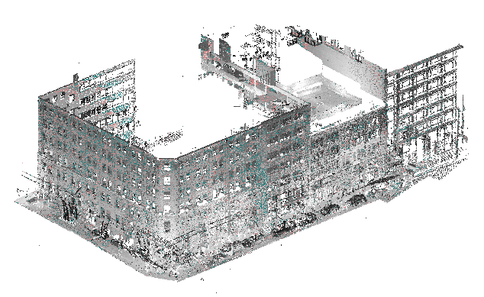
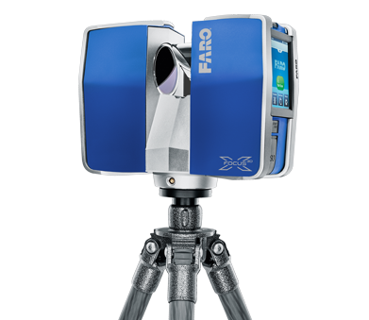
With laser scanning becoming more and more popular as a form of surveying.
Laser scanning produces point clouds which are great but not usually what a customer wants
We need to make the point cloud usable – more structured
Notes:
Intro slide
Basically prop abstract

Slide 3
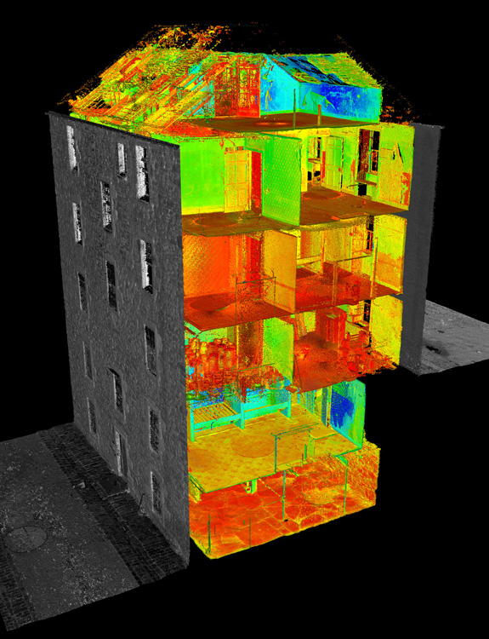
Interior of buildings are notoriously difficult to navigate as a point cloud
Creating a wire-frame model of the interior of the building makes it easier navigate or to use in a practical way

Slide 4
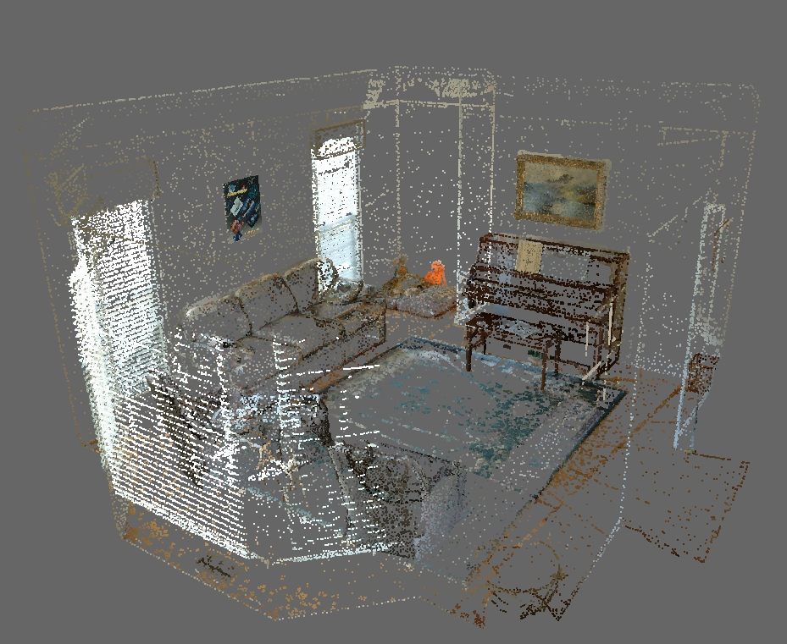

Slide 5
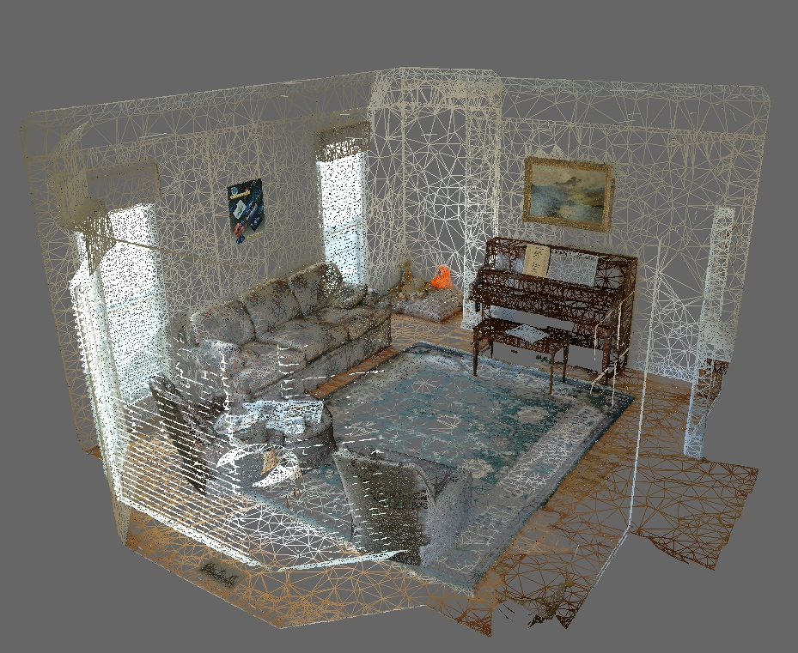

Slide 6
